Slide 1
Integration and Regression Testing Lessons Learned
Jeremy Lerch
Afshin Chaharmahalian
Xiang Cheng

Slide 2
Purpose
Provide an overview of the lessons learned about integration and regression testing on the ClubUML project

Slide 3
Agenda
Cost to Fix Defects
Static Testing
Writing Good Test Cases
Integrate Early and Often
Continuous Integration
Questions

Slide 4
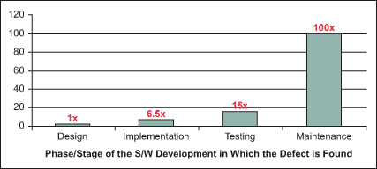
Cost to Fix Defects
Source: IBM Systems Sciences Institute

Slide 5
Static Testing
The process of identifying defects in code through either manual or automated inspection of the source code
Is not a replacement for dynamic testing but can be used to help identify defects earlier in the development cycle
ClubUML utilizes a code review process as part of the integration checklist
Commercial tools such as Klocwork or Lint can also be used to perform automated static testing

Slide 6
Writing Good Test Cases
Good test cases are written to attempt to break the software, rather than to ensure that they will pass
It is important to test the software under normal circumstances and use but also test with unusual or unexpected inputs
Ensuring that test cases cover the boundary conditions is also important
It is not feasible to test every possible input of a system so test cases should be written in a way that they test areas where defects are more likely to be introduced

Slide 7
Integrate Early and Often
It is important to integrate and test code early and often in the development process
This prevents “big bang” integration testing where all modules are developed and tested individually then integrated together in one event
This can be costly as it is much more difficult to identify the source of any defects as all the new code is introduced at one time
It also delays the identification of any defects, making them more costly to fix

Slide 8
Continuous Integration
An industry practice where all code changes are continuously integrated into the baseline
Is useful in identifying issues with integrating new software earlier in the development cycle
Code changes are merged often and the software is automatically rebuilt
Automated unit tests are run to verify that the new code works correctly and did not break any existing functionality
Developers are responsible for maintaining the automated test cases as they introduce new code or modify existing code

Slide 9
Questions

